Slide 1
Time series pattern
1. Markov Model
2. Hidden Markov Model
3. Data Mining
4. SARIMA
5. Neural Network

Slide 2
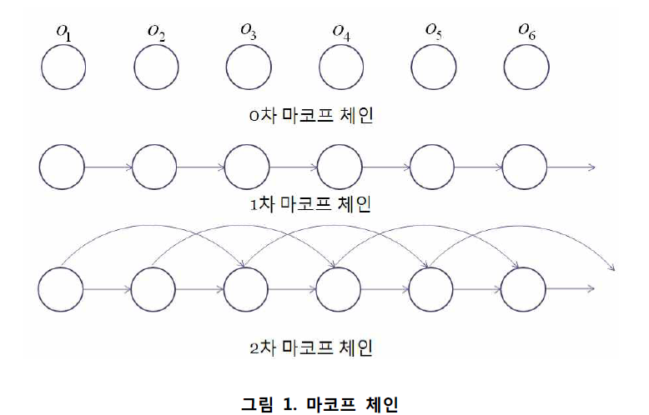
1. Markov Model
http://visbic.cse.pusan.ac.kr/~dhlee/wiki/images/f/fe/TR_%EA%B9%80%ED%83%9C%ED%98%95.pdf

Slide 3
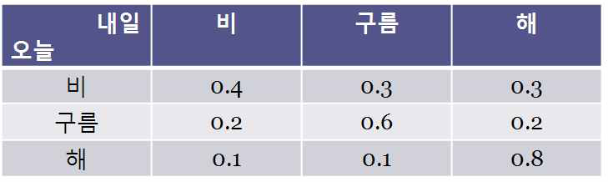
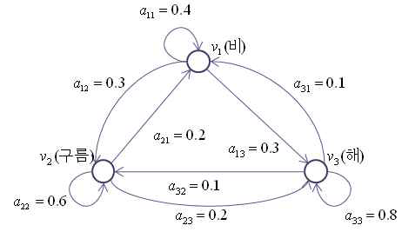
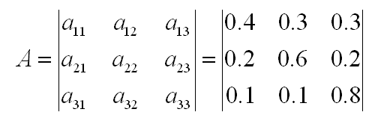
1. Markov Model
P(o = 비|o = 비, o = 비, o = 비)
P(o = 비|o = 비, o = 비, o = 해)
P(o = 비|o = 비, o = 해, o = 비)
P(o = 비|o = 비, o = 해, o = 해)

Slide 4
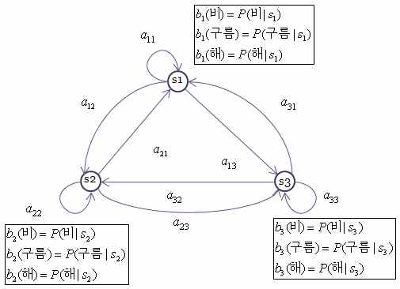
2. Hidden Markov Model
= S

Slide 5
2. Hidden Markov Model
Ergodic model
  Every a_{ij} is positive.
  Every transition is possible.
Left-to-right (Bakis) model
  a_{ij} = 0, j<i
  Cannot go backward
  Good to model temporal structure of speech signals
isoft.postech.ac.kr/Course/CS730b/2005/speech_lecture2.ppt

Slide 6
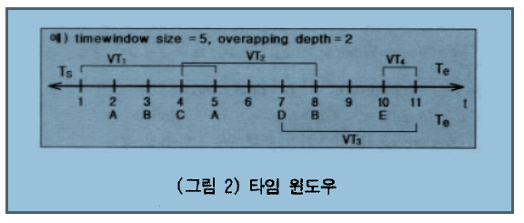
3. Data Mining
http://www.aistudy.co.kr/paper/pdf/transaction_kim.pdf

Slide 7
4 .SARIMA-Modelling
Seasonal Autoregressive Integrated Moving Average Processes
1. SARIMA – Differencing
2. SARIMA – Autoregressive Terms
3. SARIMA – Moving Average Terms
4. SARIMA – Seasonal Terms

Slide 8
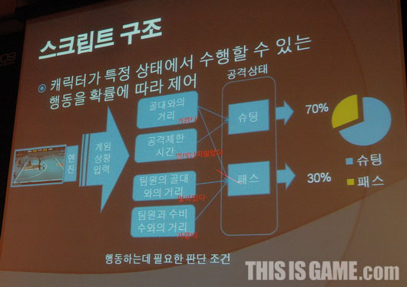
5. Neural Network

Slide 9
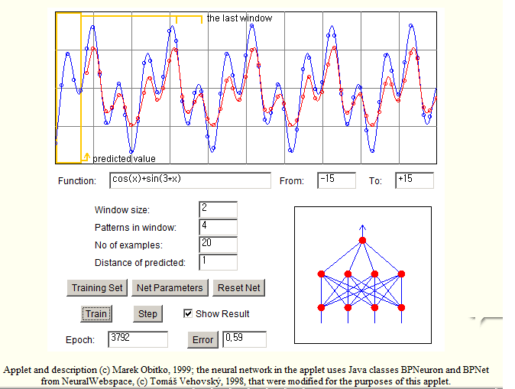
5. Neural Network
http://www.obitko.com/tutorials/neural-network-prediction/function-prediction.html#applet

Slide 10
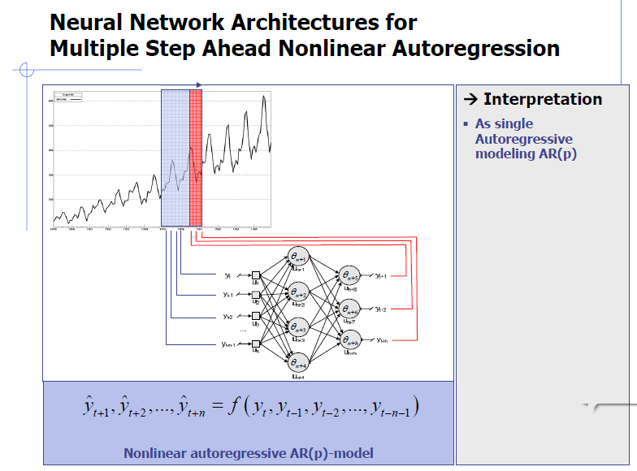
5. Neural Network
EVIC'05 Slides - Forecasting with Neural Networks Tutorial SFCrone

Slide 11
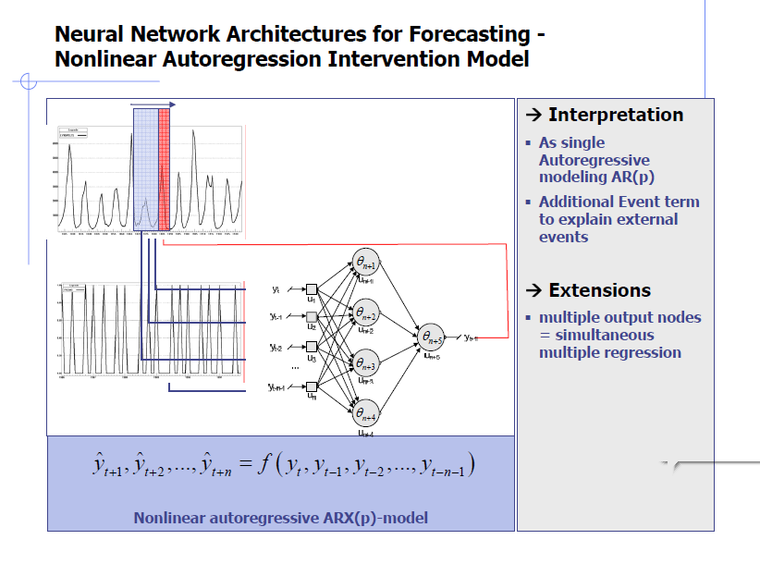
5. Neural Network

Slide 12
5. Neural Network
적과의 거리,
적의 상태( 점프,공격,회피)
나의 상태(점프,공격,회피)
점프
거리
점프
공격
공격
회피
회피

Slide 13
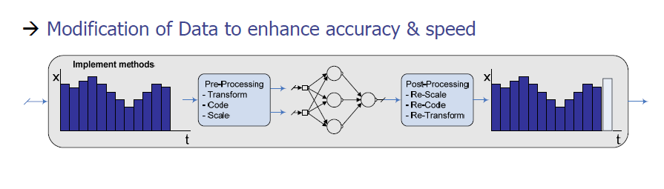
5. Neural Network
입력파라미터 정규화
A 적과의거리 => 0 ~ 1
B 전진 => 0,1
C 후진 => 0,1
D 점프 => 0,1
(BCD관련입력데이타3개필요)
입력 파라미터 줄이기
B 전진 => 00
C 후진 => 01
D 점프 => 11
(BCD관련입력데이타2개필요)
B 전진 0~0.3
C 후진 0.3~0.6
D 점프 0.6~1
(BCD관련입력데이타1개필요)

Slide 14
5. Neural Network
0,1
0~1
0,1
0,1

Slide 15
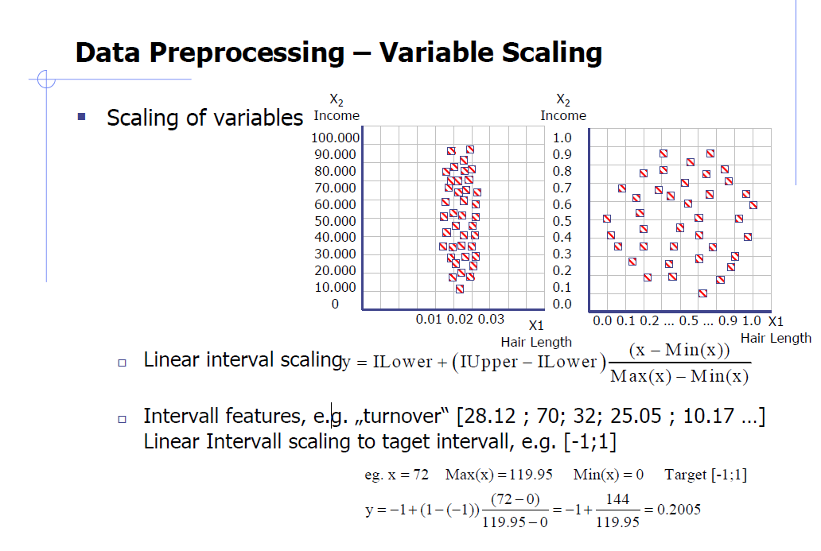
5. Neural Network

